Slide 1

CREATIVE SCRAPYARD
A CHANGE TO NATURE

Slide 2
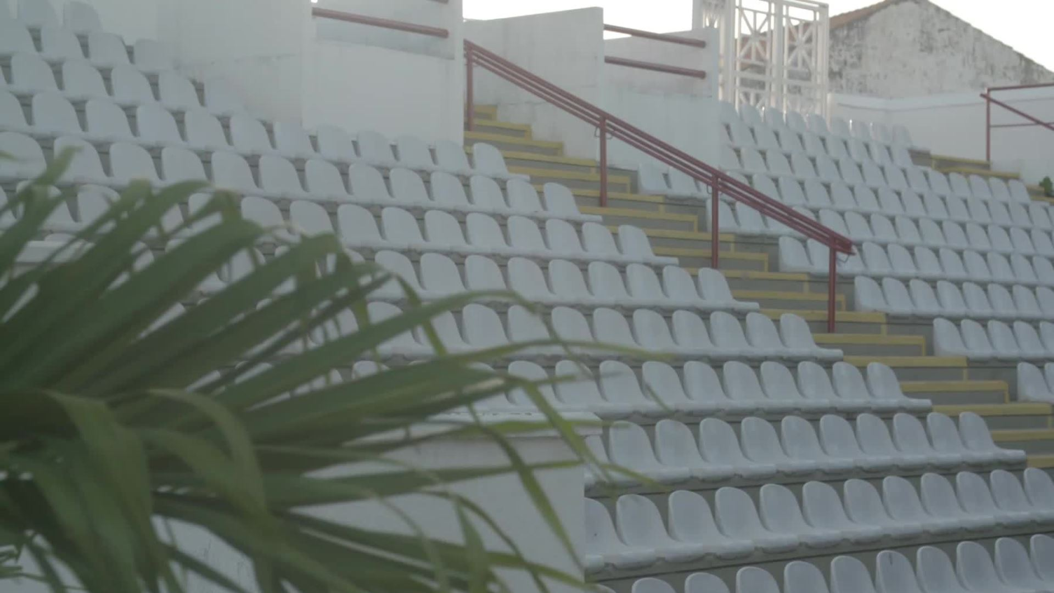
TEAM MEMBERS
SAKSHAM SHARMA
HARSH GOEL
NIKHIL KUMAR MAURYA

Slide 3
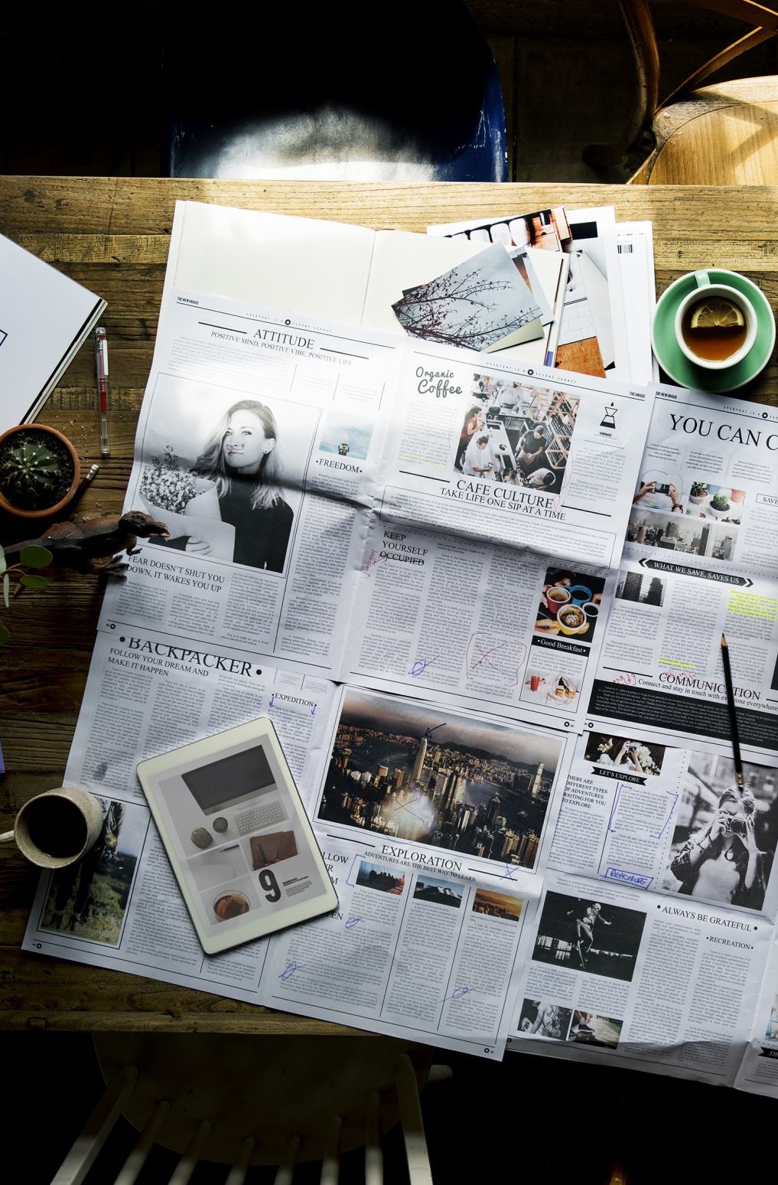
ABOUT CREATIVE SCRAPYARD
A Creative Scrapyard is an ecommerce website that aims to be a platform where people can sell their items or old scraps
From our website, An artist can buy those items to make decorative items
These creative can be sold on the website itself and other people can buy these items
It help people to earn by selling their scrap ,it help the artist to buy stuffs on cheap rates and earn money by showing their creativity on it and it will also promote the initiative of #Vocalforlocal and make the world "A Better place" by recycling old items.

Slide 4

OBJECTIVES
Our primary objective is to convert the scrap into a useful artistic product which in turns satisfy the user and artist requirements.
Transparency in material valuation
Saving mother earth by reusing the Scrap and creating "#valueformoney"
To satisfy the customer needs through an environment of transparency in communication ,collective responsibility and progress

Slide 5
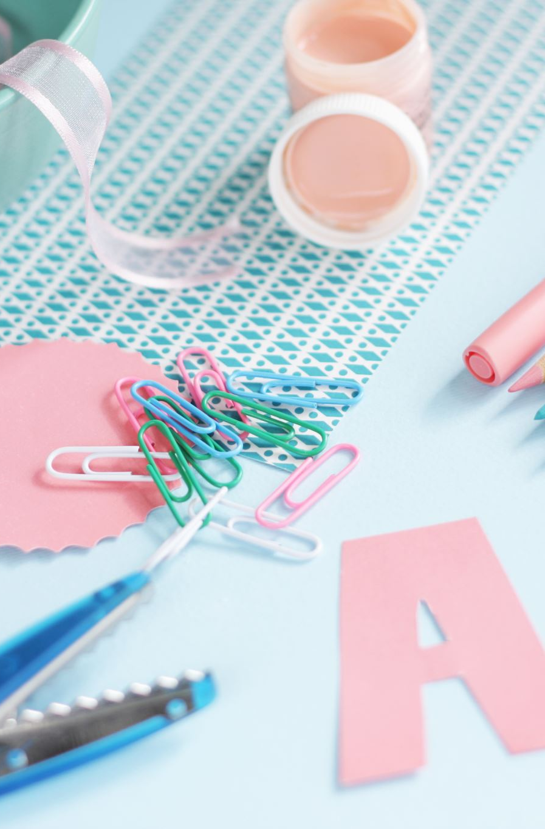
EXISITING SYSTEM
There is currently no such existing system where a user can sell their items or scrap and from which the artist can buy those scraps and then recycle it and turn into a creative useful item.
There are several ecommerce website where artist can sell their creative items and where user can buy these items online. Some of these websites are specifically based on creative and art stuff but it is a tedious task to sell items in these existing system because of which many artist prefers social media platforms.

Slide 6
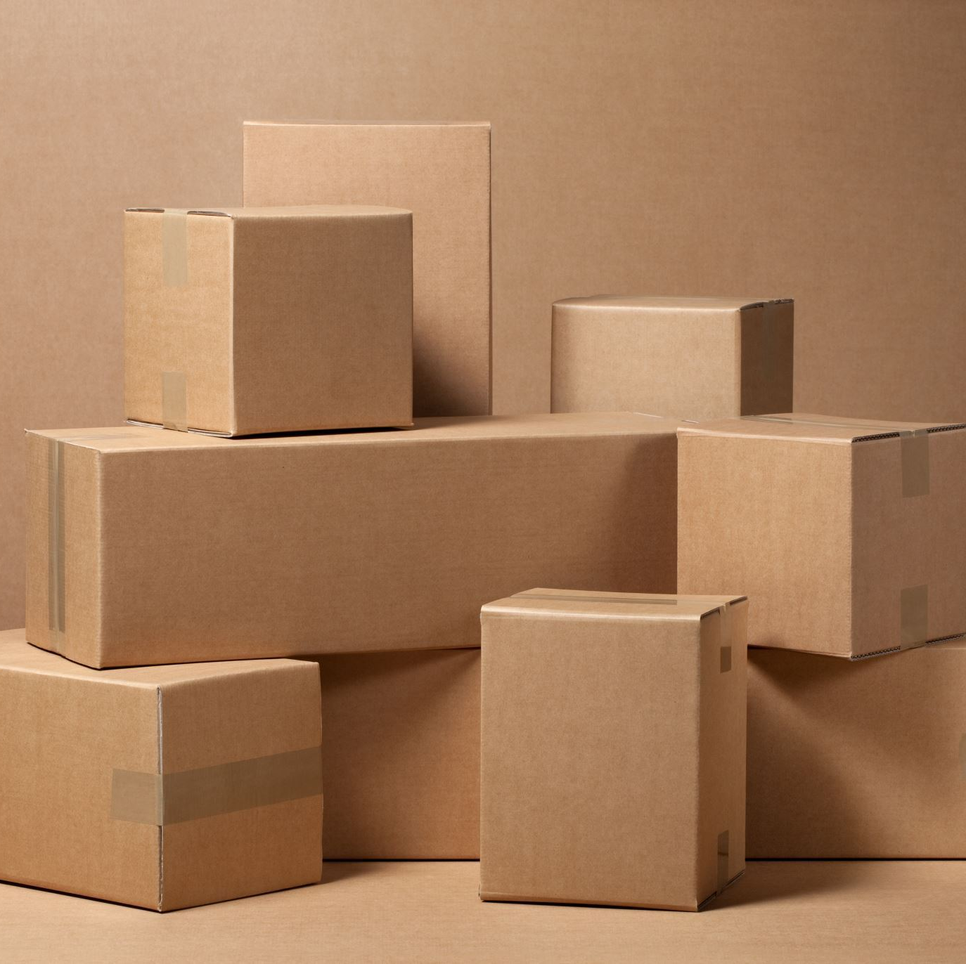
PROPOSED SYSTEM
Our website is divided into two main sections: Creative Store and Scrapyard.
A user can sell any of his useless things or scrap items on the platform by creating an item, this will be displayed in the scrapyard section of the website.
A user who is an artist can sell his own creative items like arts, crafts, and customized material by posting them on the creative section of the website.
A user can also buy scrap items and can customize it to turn it into something useful and decorative stuff and can sell it on the creative store with value addition.

Slide 7
TOOLS AND TECHNOLOGIES
Frontend Technology
➤ HTML5
➤ CSS 3
➤ JavaScript
Backend Technology
➤ Python (3.8) - Django Framework (3.0)
➤ MySQL (5.0)
Tools
➤ Presentation Tool: Microsoft Office PowerPoint 2019
➤ Drawing Tool: Draw.io
➤ Bootstrap 4.5

Slide 8
BENEFITS
Environmental Impact
Improves Health
Generates Money
Reduces Pollution
Energy Conservation
Creates Employment
Exploring Alternatives

Slide 9
FUTURE SCOPE
The future of Scrap management starts and proceeds with technological adjustments. Like every other industry, to proceed, the waste management industry needs to become digitized and data-driven to advance its work field.
Using New technologies in front , there is better scope for future enhancement ,we can scale up the business by adding new features and working on the feedback provided by the customer.
New fields can be added in future for scaling up the business which in turns can maximizes the revenue of our business model and can provide employment for job seekers.

Slide 10
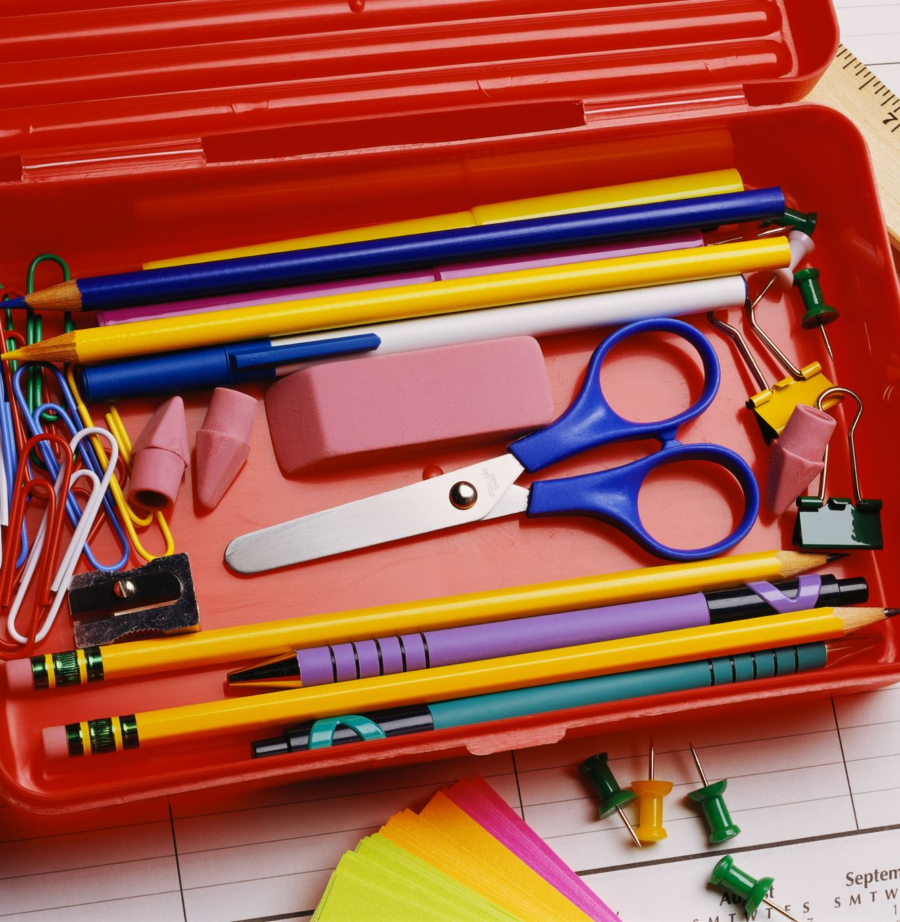
CONCLUSION
Provided Overview concept shows how much can be done with the household items so many people throw away. There are thousands more creative ideas out there. As mentioned before, Schools today have a lot they can teach students about the environmental benefits of recycling scrap metal. It is great for the environment to do something creative with these items. Also, it potentially saves money when you can build something that you otherwise would have paid for – in turn creating more clutter and more waste. So next time you’re about to pitch something into the trash, have a good think about how you could repurpose it.

Slide 11

THANK YOU

